Slide 1
2.2 The Zero-Order Condition for Optimality

Slide 2
In this Section we describe most basic mathematical definition of a function's minima - called the zero-order condition.

Slide 3
The zero-order definitions

Slide 4
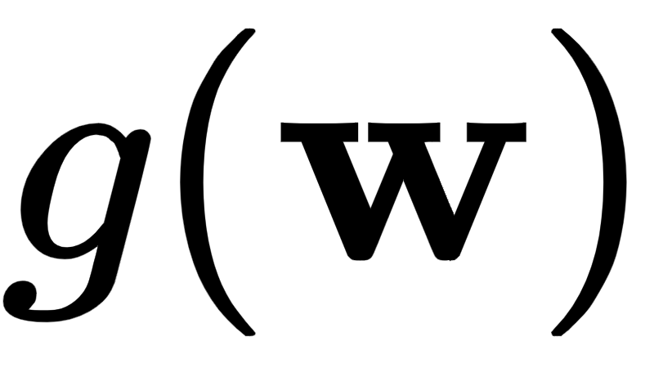

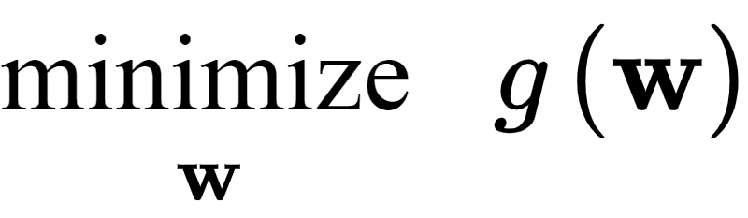
In many areas of science and engineering one is interested in finding the smallest points - or the global minima - of a particular function.
For a function taking in a general N dimensional input this problem is formally phrased as
This says formally: look over every possible input and find the one that gives the smallest value of .

Slide 5
Lets first visually examine a few simple examples.
In each case keep in mind how you would describe a minimum point - in plain English.
After each picture we will then codify this intuitive understanding - forming our first formal definition of minimum points.

Slide 6
Example: Global minima of a quadratic

Slide 7
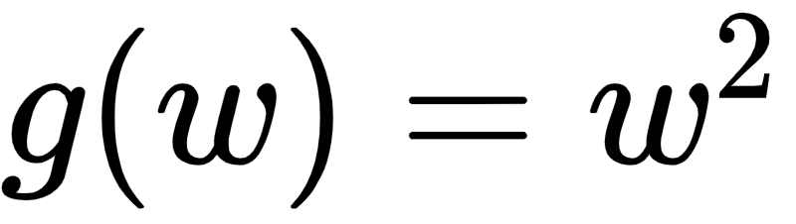
Below we plot the simple quadratic over a short region of its input space.
Examining the left panel below, what can we say defines the smallest value(s) of the function here?

Slide 8
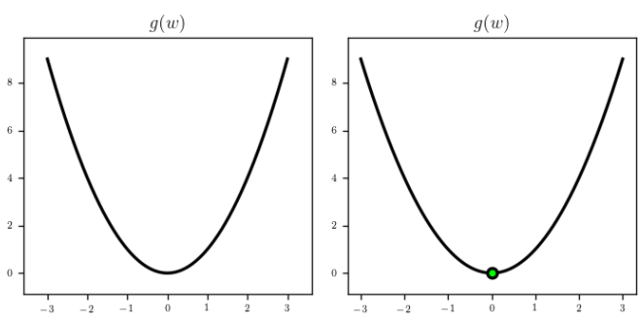

Slide 9
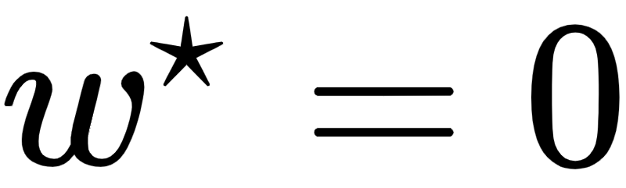
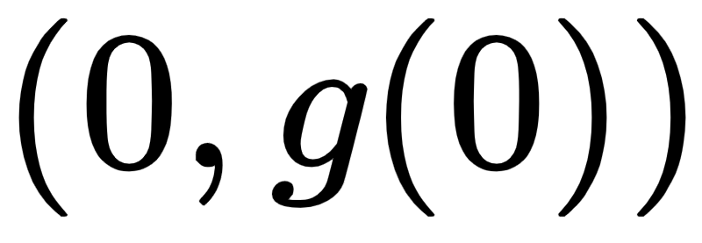
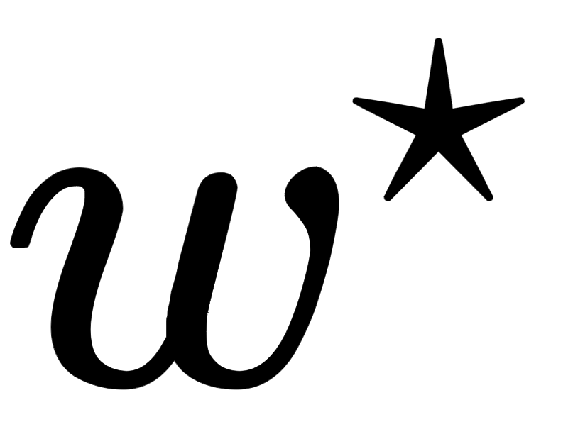
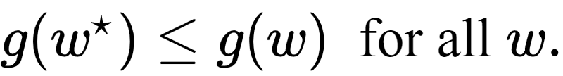
Certainly the minimum is smaller than any other point on the function.
Specifically the smallest value - the global minimum of this function - seemingly occurs close to (marked as a green dot in the right panel).
Formally a point gives the smallest point on the function if
This formal translation of what we know to be intuitively true is called the zero-order definition of a global minimum point.

Slide 10
Example: Global maxima of a quadratic

Slide 11
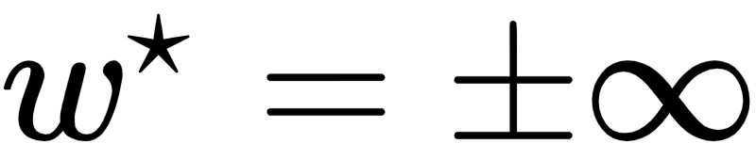
Remember what happens if we multiply the quadratic function in the previous example by -1, as plotted below.
The function flips upside down - now its global minima lie at
Now the point that used to be a global minimum is a global maximum - i.e., the largest point on the function (and is marked in green in the right panel below).

Slide 12
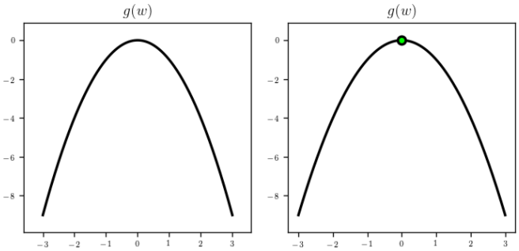

Slide 13
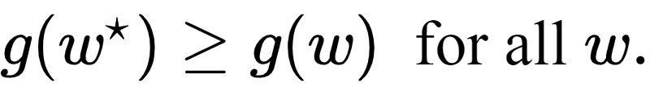
How do we formally define a global maximum?
Just like the global minimum in the previous example - it is the point that is larger than any other on the function i.e.,
This direct translation of what we know to be intuitively true into mathematics is called the zero-order definition of a global maximum point.

Slide 14
These concepts of minima and maxima of a function are always related to each via multiplication by -1.
That is, any point that is a minima of a function g is a maxima of the function -g, and vice-versa.

Slide 15
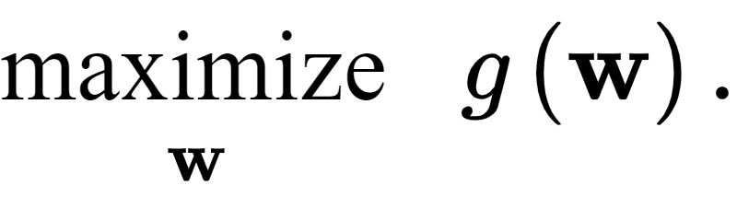
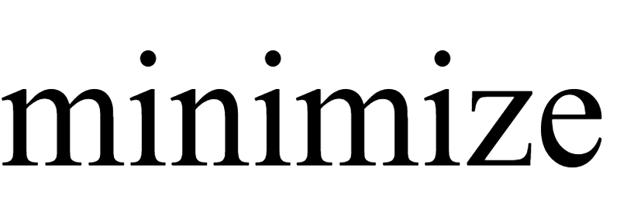

- To express our pursuit of a global maxima of a function we write
- But since minima and maxima are so related, we can always express this in terms of our notation as

Slide 16
Example: Global minima/maxima of a sinusoid

Slide 17
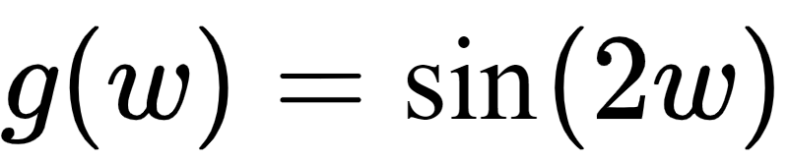
Let us look at the sinusoid function plotted below.
Here we can clearly see that - over the range we have plotted the function - that there are two global minima and two global maxima (marked by green dots in the right panel).

Slide 18
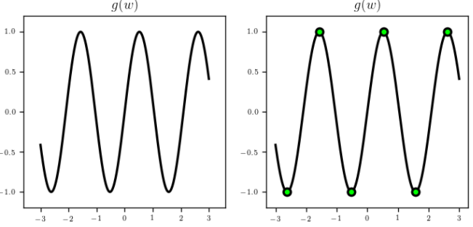

Slide 19
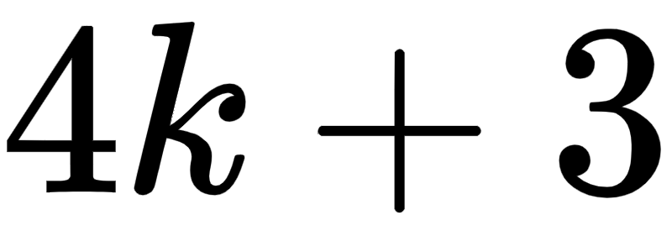
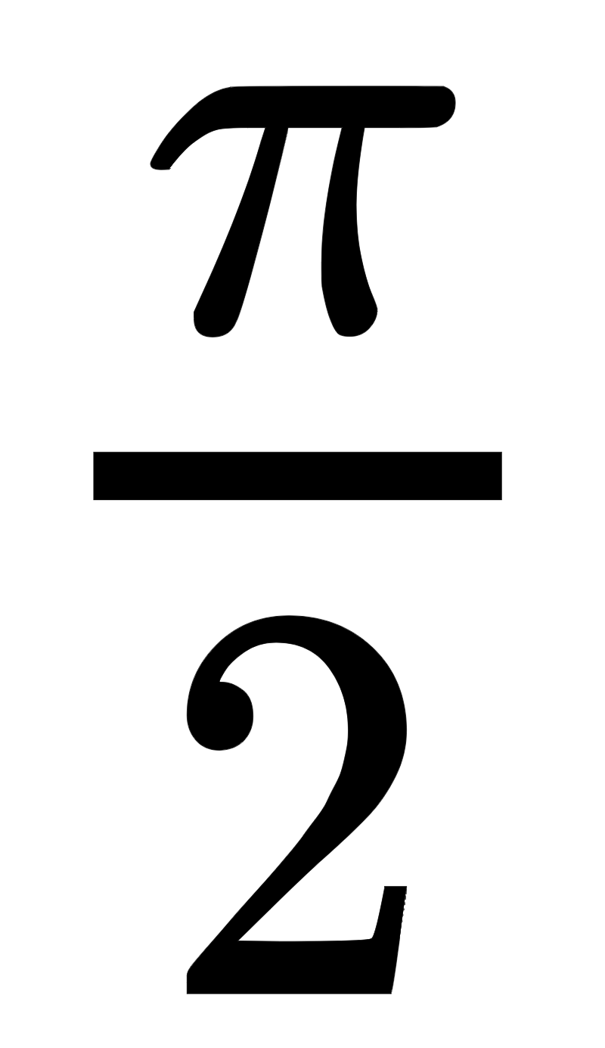
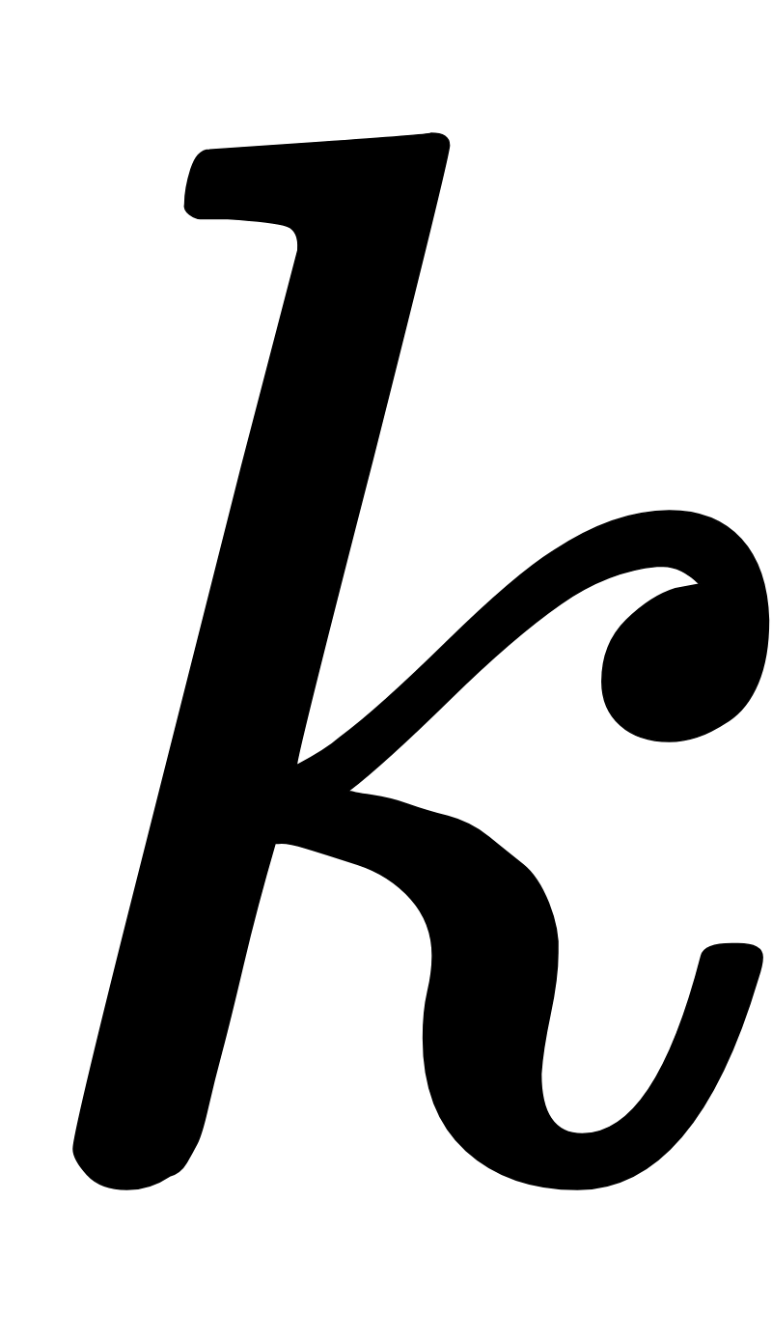
We can imagine as well of course that there are further minima and maxima (here one exists at every multiple of for integer 's).
This is just an example where - technically speaking - the function has an infinite number of global minima and maxima.

Slide 20
Example: Minima and maxima of the sum of a sinusoid and a quadratic

Slide 21
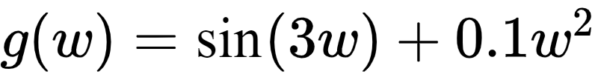
Let’s look at a weighted sum of the previous two examples, the function
over a short region of its input space.
Examining the left panel below, what can we say defines the smallest value(s) of the function here?

Slide 22
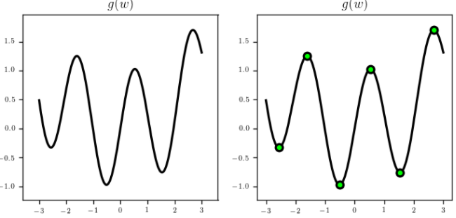

Slide 23
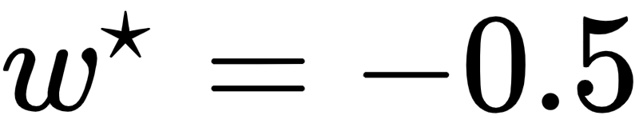
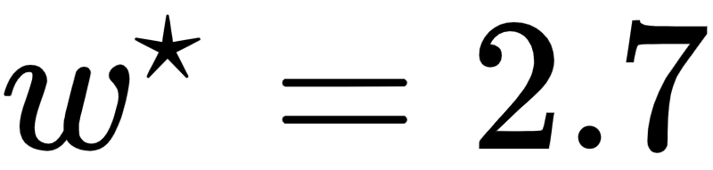
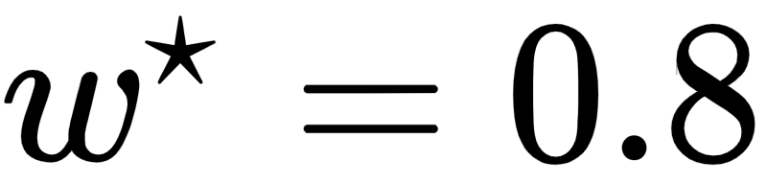
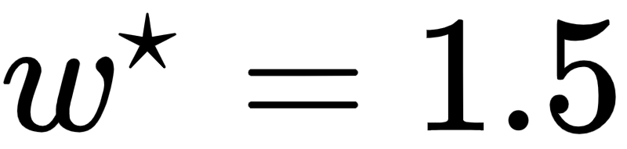
Here we have a global minimum around and a global maximum around
We also have minima and maxima that are locally optimal - for example the point around is a local maximum.
Likewise the point near is a local minimum - since it is the smallest point on the function nearby.

Slide 24
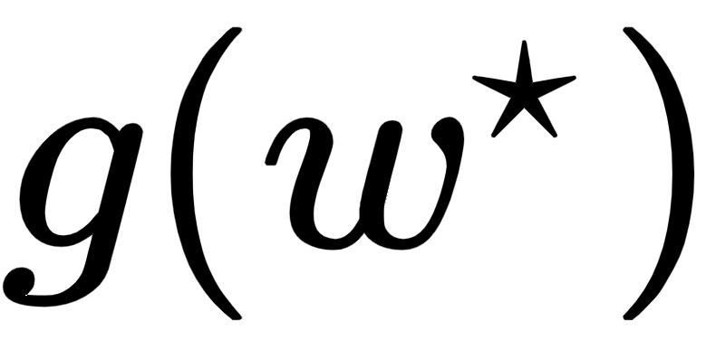

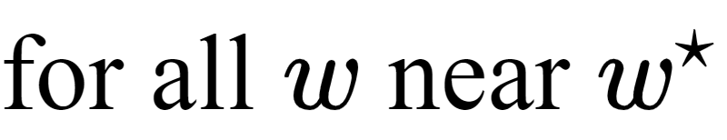
We can formally say that the point is a local minimum of the function as
The statement is relative, and simply describes the fact that the point is smaller than its neighboring points.

Slide 25
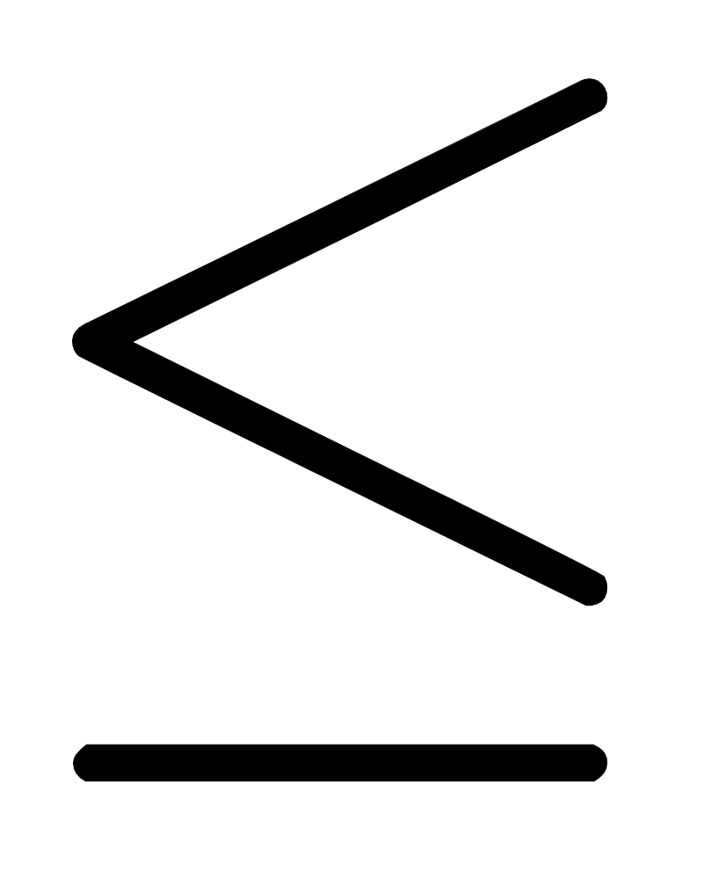
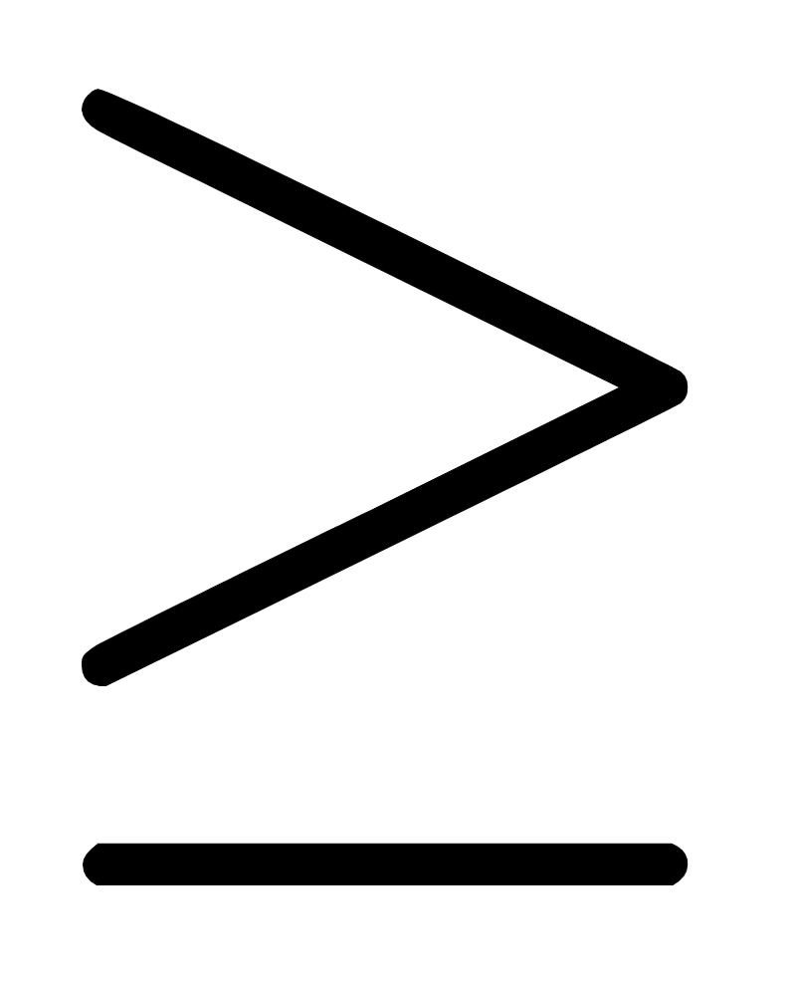
This is the zero-order definition of local minima.
The same formal definition can be made for local maximum points as well, switching the sign to , just as in the case of global minima/maxima.

Slide 26
The zero-order condition for optimality

Slide 27
From these examples we have seen how to formally define global minima/maxima as well as the local minima/maxima of functions we can visualize.
These formal definitions directly generalize to a function of any dimension - in general taking in N inputs.
Packaged together these zero-order conditions are often referred to as the zero-order condition for optimality.

Slide 28
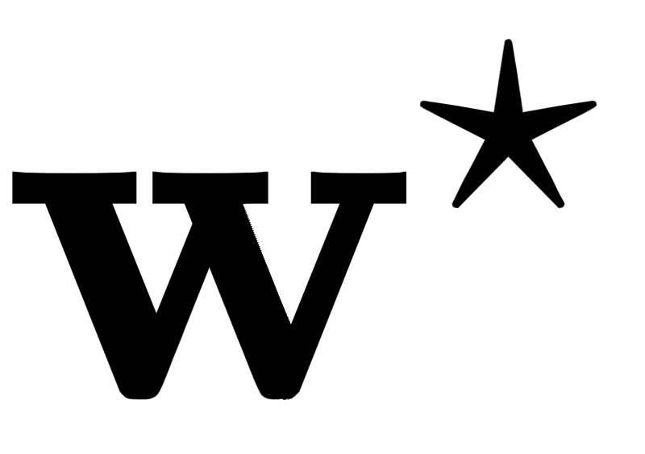
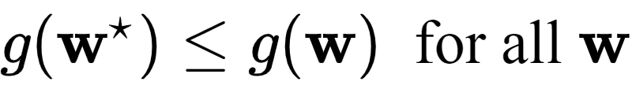
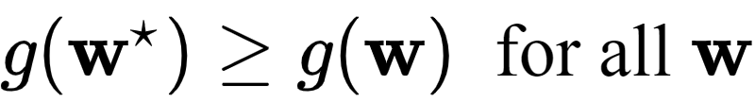


The zero order condition for optimality: A point is
- a global minimum of if and only if
- a global maximum of if and only if
- a local minimum of if and only if
- a local maximum of if and only if

Slide 29
The zero-order jargon, in context

Slide 30
Here we have seen zero-order definitions of various important points of a function.
Why are these called zero-order conditions? Because each of their definitions involves only a function itself - and nothing else.

Slide 31
This bit of jargon - 'zero-order'- is commonly used when discussing a mathematical function in the context of calculus where we can have first-order, second-order, etc., derivatives e.g., a zero-order derivative of a function is just the function itself.
In the future we will see higher order definitions of optimal points e.g., first-order definitions that involve the first derivative of a function and second-order definitions involving a function's second derivative.

